Slide 1


Agenda
Hook Methods in a Controller
Control Hierarchy
Concept of Multiple Controller
Concept of Model in SAP UI5
Steps to Create a Model
Addressing Model Properties
Binding Modes in SAP UI5

Slide 2
Hook Methods in a Controller
SAPUI5 provides predefined lifecycle methods for controller. These are also called controller lifecycle hooks. These methods are
onInit()
onBeforeRendering()
It is a function which gets called immediately after UI5 creates the object of our controller. It is like constructure of a class. We can use this to initialize our class variable
It is a method which gets called MULTIPLE times, Before every time the view is displayed to the user. This is similar to PBO of a screen. We can use this method for pre-processing on a view.
IN
BR
EX
AR
onExit()
onAfterRendering()
It is a function which gets called before the instance of our controller gets destroyed. It is like destructor of a class.
We can use this to write clean-up code.
It is a method which gets called MULTIPLE times, After every time the view is displayed to the user. This method can be used to show effects to the user.

Slide 3
Control Hierarchy
sap.ui.base.ManagedObject
Syntax to create object
var oName = new libraryName.ControlName({
prop: Val,…
});
Note:- Whenever we see a control, and if we are unable to find a property, association, event or function in that class, check its parent class.
sap.ui.core.Element
sap.ui.core.Control
sap.m.Button
sap.m.InputBase
sap.ui.view
sap.m.Table
sap.ui.layout.form
sap.m.Input
SimpleForm
sap.m.Column
Some of the Frequently used controls in SAP

Slide 4
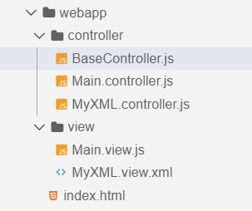
Concept of Multiple Controllers
Base Controller:- A base controller is a controller with basic functionalities from which the other controllers in your SAPUI5 application inherit.
The base controller holds basic functionalities that are used across multiple controllers.
The base controller itself is just another JavaScript file and it does not have the .controller prefix. Just BaseController.js and not BaseController.controller.js.
The base controller goes in the controller folder in your SAPUI5 application folder structure:
sap/ui/core/mvc/Controller
x
BaseController
Template
x
Controller 1
x
Controller 2
x
Controller 3
x
Controller 4
View 1
View 2
View 3
View 4

Slide 5

Exercise 1
In this exercise we will create a BaseController.
And we will get to know how our hook methods work.
Exercise Code:-
MyXML.view.xml
MyXML.controller.js
BaseController.js

Slide 6
Concept of Models in SAP UI5
The various model types supported by SAPUI5 are:
OData model
JSON model
XML model
Resource model
Each model in SAPUI5 is mainly used to bind controls to the data brought in. The JSON model is a client-side model which is recommended for datasets with small amounts of data.
Usage of Models:
100
100
100
95
80
Usage in Percentage
60
40
40
20
Models
OData
JSON
XML
Resource

Slide 7
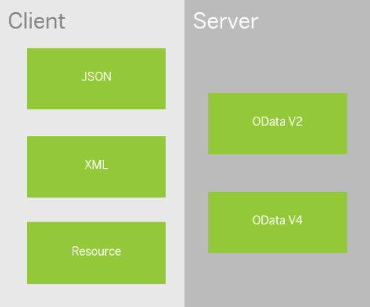
Basics of Models
All the models in SAP UI5 are characterized in two different parts:
Client Side Model: -
A model which keeps all the data in the browser. We use client side model for manipulating data (like internal table).
Server-Side Model: -
Keeps data on server side, and ON-demand, it is loaded by client using the server side model.
We can use the APIs (Methods) provided by SAP to access data from model
We need to get model object using methods
getModel(modelName)
setModel(modelName)
From model object we get access to the data using methods
setProperty(sPath, sValue)
getProperty(sPath)

Slide 8

Steps to Create a Model
3 Easy Steps to Create a Model
Step 1: Create a brand new object of the Model
To Create JSON Model - var oModel = sap.ui.model.json.JOSNModel()
To create XML model – var oModel = sap.ui.model.xml.XMLModel()
To create Resource model – var oModel = sap.ui.model.resource.ResourceModel()
To create OData Model – var oModel = sap.ui.model.odata.v2.ODataModel()
Step 2: Set or Load the data in the Model
oModel.setData({});
oModel.loadData(filePath);
Step 3: Make the model aware to the application/view
sap.ui.getCore().setModel(oModel);
this.getView().setModel(oModel);

Slide 9
How to Address Model Properties?
In the json data we can make address as “Every curly braces is converted to / and every array item is converted to /index”.
{
"empStr": {
"empId": 0001,
"empName": "Anubhav",
"salary": 8000,
"currency": "USD"
},
"empTab": [{
"empId": 0009,
"empName": “Ananya",
"salary": 9500,
"currency": "USD“
}, {
"empId": 0010,
"empName": “Shwetha",
"salary": 10000,
"currency": “EUR"
}]
}
Q: what is the salary of Anubhav
/empStr/salary
Q. What is the emp name of emp 0001
/empStr/empName
Q. What is the salary of Shwetha
/empTab/1/salary
Q. What is the empId of Ananya
/empTab/0/empId

Slide 10
Binding Modes
There are basically three modes of binding data in SAPUI5.
One-way binding – Here, the data is transported in one direction only, i.e. from the model, through the binding instance to the consumer (usually the property of a control), but never in the other direction. Any change done on the model data from the front end is not affected to the model. All the data changes are reflected only on the controls.
Two-way binding – Here all input changes done from front end controls are reflected on the model and the backend database. SAPUI5 automatically handles the transport of data both from the model to the controls and back from the controls to the model.
One-time binding – Here all data will be bound from model to view just once. After that, the connection is no more set.

Slide 11

Exercise 2
In this Exercise we will create a JSON Model in the controller and bind it to the form fields.
Exercise Code:-
MyXML.view.xml
MyXML.controller.js
Exercise 3
In this Exercise we will create a folder named model in the our webapp folder and create a demo data files and create a model.js file to initialize the model
Exercise Code:-
MyXML.view.xml
MyXML.controller.js
sample.json
data.json
Model.js

Slide 12

End of Day 7

Slide 13

Any Questions ?

Slide 14

Anubhav Oberoy

Slide 15
Title
Content

